Slide 1

Notes:
Ladies and Gentleman,
my name is Valentyn Yanchuk, I represent Hermitech Laboratory, making the software for Education and for Mathematical Modeling in particular. Today I present you one of the most popular products belonging to the MathML Suit - the software for creating the learning activities entitled Tarsia.

Slide 2


Goals
Goal: Learn to use Tarsia for teachers, to make the learning materials increasing:
  motivation of pupils,
  teacher-pupil interaction
  developing the mathematical thinking
Notes:
Today I will guide you through Tarsia to show how this software can be used in your everyday work with pupils and students. Applying the learning activities in class you will interact fruitfully, earn increasing of pupils’ and students’ motivation, increase their skills in mathematical thinking.

Slide 3

Agenda
Learning Activities – what is this?
Tarsia
Application of Tarsia and templates transformations
Resources for teachers
Further development of the software
Questionnaire
Notes:
We start with the definitions of LA, know how to use them in class and what can Tarsia do for you to automate LA creation. Detail overview of the software will give you a glance to the best practices of people using Tarsia for years. Having created the LA once you will transform them further in attractive shapes of nice-looking puzzles. Overview of the resources will show how big the world of Tarsia is. You will be informed about further development plans and your feedback to the questionnaire will give us a view to your real needs.

Slide 4
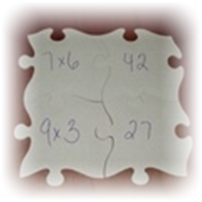
Background for LA
LA = learning + activities
Activity means:
the state of being active;
a physiological process.
Learning activity means active learning via physical manipulation with objects.
Notes:
What does the Learning activities mean? LA means active learning via physical manipulation with objects, since it is derived from Activity to stimulate learning.

Slide 5
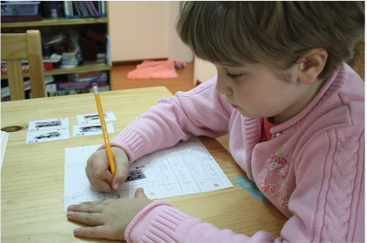
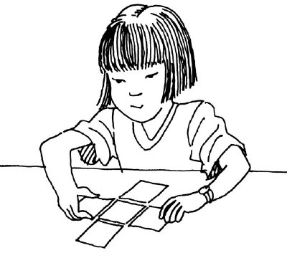
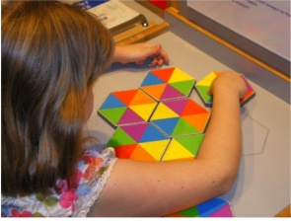
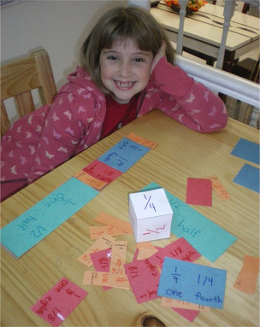

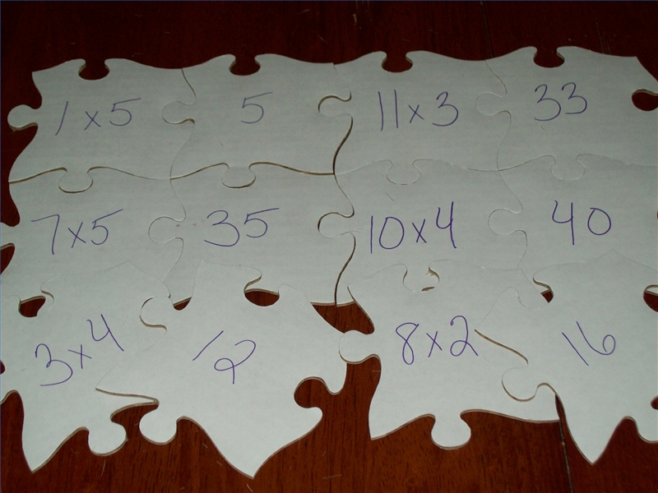
Learning activities for kids
Notes:
Indication of the activities children solve while they learn something. This is not the only thinking process, it is also the manipulation with the objects, grouping operations and finally puzzle solving. You may see how concentrated children are and how glad they are to do this task.

Slide 6




Age groups
7-9
years old
13-16
years old
3-6
years old
10-12
years old
Tarsia covers all the age groups a kindergartens and schools are focuses on.
Notes:
Tarsia covers all the age groups from the kindergartens up to the University level. You can create learning activities to motivate all these groups.

Slide 7

Recognition of mathematically gifted children
In all age groups gifted children are:
the quickest;
creative: find the best way to solve the puzzle
(grouping similar pieces, outstanding way to build up the solution).
Gifted children can be assigned more complicated puzzles to see other facets of their talent.
Notes:
Interacting with your learners you can know them better – to disclose their talent. Creative and gifted children find the best way to solve the puzzle (grouping similar pieces, outstanding way to build up the solution). Usually they solve the puzzle much quicker than others.

Slide 8
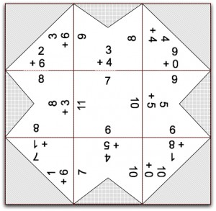
Specific learning environment
Highest motivation;
Space orientation abilities;
Problem-oriented tasks
Giving the informal view to the material is the best approach to focus children on the subject.
Notes:
The learning environment with learning activities is highly motivating, developing the space orientation abilities. Informal view to the problem sometimes is the best way to get better solution.

Slide 9
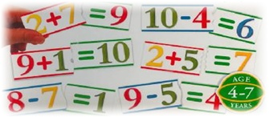
Learning activities are multipurpose
Focused on a subject;
Easy to create (equivalent pairs)
Cover several aspects of
learning;
A sort of a competition
in a group;
Can be easily and immediately transformed
(the teacher can always change the task and solution will go in a different way).
Notes:
Benefits of the learning activities are great:
They are easy to create;
children are focused on a subject;
Cover several aspects of learning at once;
A sort of a competition in a group;
Can be easily and immediately transformed in class
(the teacher can always change the task and solution will go in a different way).

Slide 10
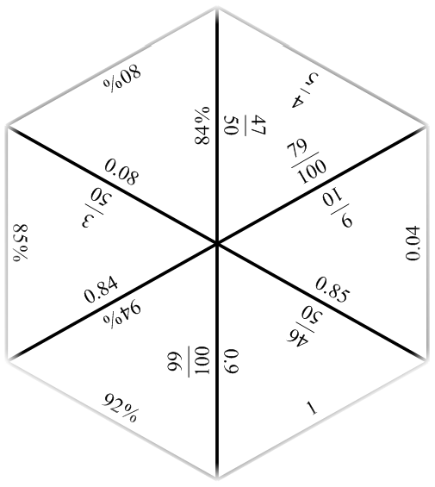
Computer-aided development of the learning activities
MS Word’s templates;
Vector Graphics editors;
Raster Graphics editors;
Specialized software
for learning activities
creation (Tarsia belongs to this group).
Notes:
The variety of tools for making the activities is wide, but the most useful are specialized and Tarsia belongs to this group.

Slide 11
What is Tarsia?
Formulator Tarsia makes it easy to create your own mathematical learning activities.
With Tarsia you can easily create, print out, save and exchange customized jigsaws, domino activities, students discussion circle and a variety of rectangular card sort activities.
Notes:
Tarsia helps you create, print out, save and exchange customized jigsaws, domino activities and a variety of rectangular card sorting out activities.

Slide 12
Tarsia outputs can be applied for:
Training session
New topic explanation
Training at home
Notes:
When LA can be used: during the training session and practicing at home. However teachers mention that new topics delivery supported with puzzles will be adopted much faster.

Slide 13
What Tarsia can do for you?
The activities in Tarsia can be prepared in a way ready to print and then to cut out.
There are several types of activity:
hexagonal jigsaws made up of equilateral triangles;
different sets of rectangular cards with expressions;
dominoes for a domino activity;
students discussion circle etc.
Notes:
activities in Tarsia can be prepared in a way ready to print and then to cut out.
There are several types of activity:
hexagonal jigsaws made up of equilateral triangles;
different sets of rectangular cards with expressions;
dominoes for a domino activity
students discussion circle etc.

Slide 14


Contemporary needs and field of application
Math
Linguistics
Chemistry and a lot more.
Notes:
Currently Tarsia is applied in Math (the most popular), field of Linguistics, Chemistry and much more.

Slide 15
Automated services of Tarsia
Built-in rich mathematical equation editor;
Extensibility of puzzles templates;
Solution verification;
Optimal placement of the formulae at a random slot;
Transformation of one puzzle type to another;
Expression library creation and import functions.
Notes:
Certain level of automation (benefits in comparison with paper-based and editor-based puzzles) is provided in Tarsia: Built in equation editor; Extensibility of puzzles templates;
solution verification is available at the table and output views; it provides solution verification, random placement of the formulae, transformation of one puzzle type to another etc.

Slide 16

Historical aspect
Initiated by the Ministry of Education, UK
  Standard Unit Support and Promotion
  Justification towards the official documents for educational purposes
  Centralized distribution of the materials to the learning centers (schools and colleges)
Support of Jigsaw/Tarsia fans.
Notes:
Originally Tarsia was initiated by the Ministry of Education, UK promoted by the Standard Unit, which provided the centralized distribution of the materials for the schools.
Further, Tarsia was gladly met by teachers of Math and Math society itself. Now Tarsia has its own fans around the world.

Slide 17
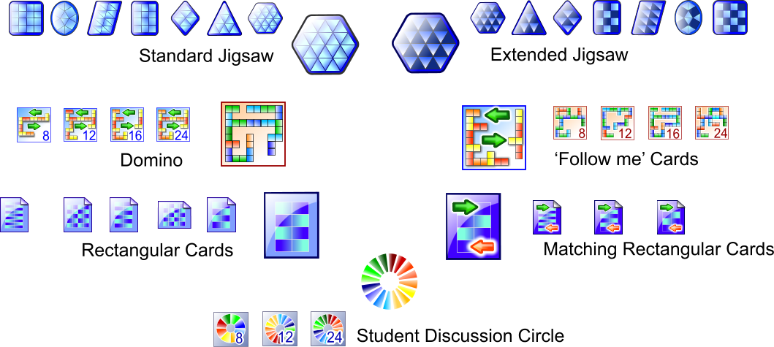
Variety of templates in Tarsia
Notes:
Variety of puzzles is big, please note here are indicated 7 groups of puzzles, namely: Standard and Extended Jigsaws, Dominos, Follow me cards, Rectangular cards, matching rectangular cards, Student discussion circle. Extended Jigsaws are more complicated in comparison with Standard once having outer unpaired expressions, where as Standard has empty edges.

Slide 18
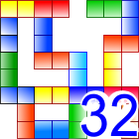
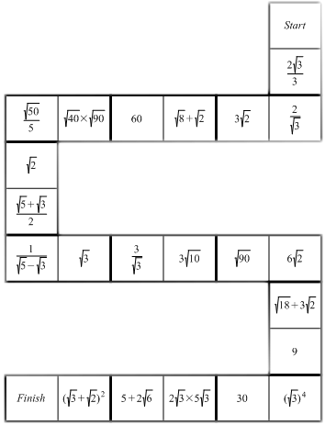
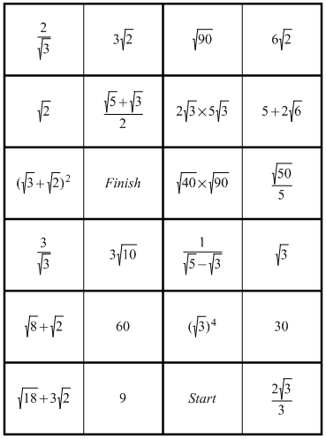

From Thinked over to Solved
Notes:
Formulator Tarsia is intended to help you prepare the activities just from the initial typing the pairs for the activity up the solved puzzle printing. Let us discover how it is made.

Slide 19
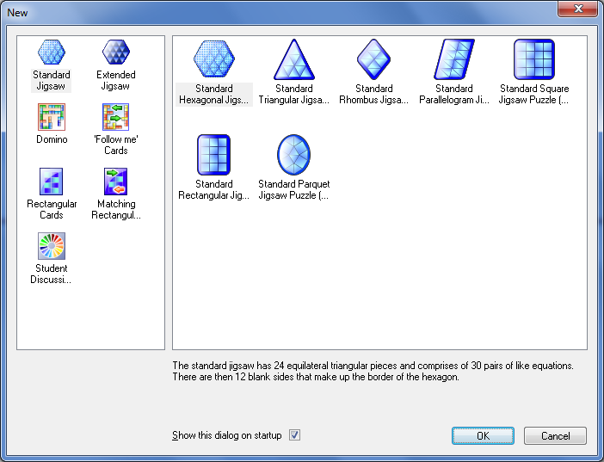
Creating the new activity
Select 'New' on the 'File' menu or click on the ‘New’ icon on the Standard toolbar.
The 'New Document' dialog box appears with the list of available types of activities.
Notes:
Creating the new activity starts from the selection of the appropriate template. The icons of activities somehow reflect the output view of the jigsaw. All the templates are provided with the description, telling what figure and kind this activity represents.

Slide 20
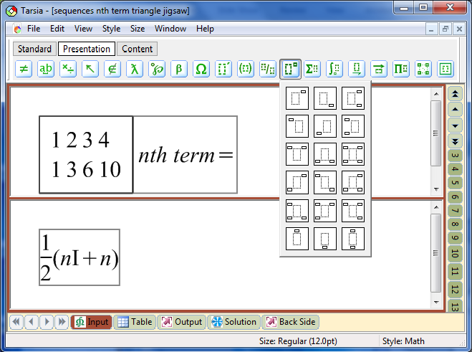
Editing expressions
1
(1) System menu;
(2) 'Formulator Expression' toolbar;
(3) 'Standard' toolbar
(4) Bottom navigation bar;
(5) Right hand navigation bar;
(6) Document area;
(7) Status bar.
2
3
6
4
5
7
Notes:
Expression editing is possible in the input view, where the equivalent pairs are to be typed. Standard toolbar can be presented in single and tabbed view (will be explained further), bottom navigation toolbar, where you switch between views. Right hand navigation bar letting you switch between input equivalent expressions.

Slide 21
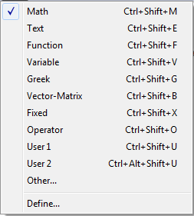
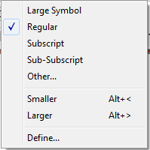
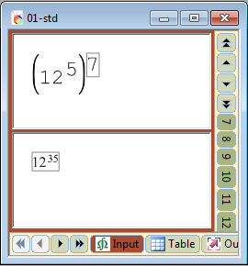
Style/Size of the expressions
Each character in a Tarsia expression can be directly assigned a specific font and character style.
By changing the style of a text fragment, a user can quickly define the appearance of all the characters using this style.
Notes:
Typing of the expression will be ultimately easy if you apply to styles and size presets. Using styles you can affect changes to those inputs provided with the certain style. The image below indicates two single expressions typed using different styles.

Slide 22
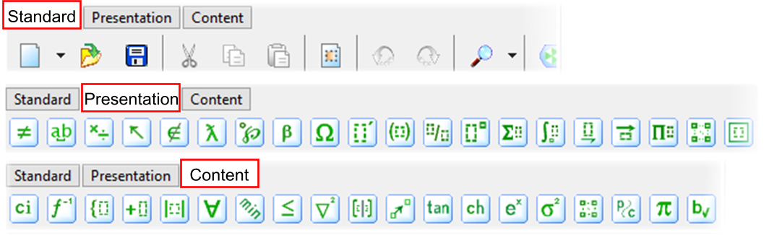
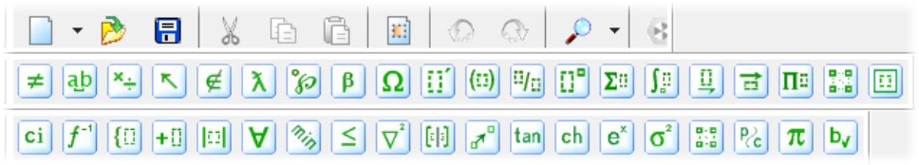
Using Toolbars and Changing Layout
Tabbed View
To speed up the expressions input and routine operations Tarsia has a large number of the keyboard shortcuts listed in the Manual.
Merged View
Notes:
Changing the Layout of the software you may have the tabbed or merged view of the toolbar depending on the preferences of the customers.

Slide 23
Variety of expression toolbar templates
• relational and logical symbols
• spaces templates
• operator symbols
• arrow symbols
• set theory symbols
• special constants
• miscellaneous symbols
• Greek characters (lowercase)
• Greek characters (uppercase)
• differentiation templates
• fence templates
• fraction and radical templates
• subscript and superscript templates
• summation templates
• integral templates
• underbar and overbar templates
• labeled arrow templates
• products and set theory templates
• table templates
• box templates
Notes:
Here we give the basic toolbar templates list and as you see it is really a big list. Each of groups comprises the specific templates, which can be indicated at further slides.

Slide 24
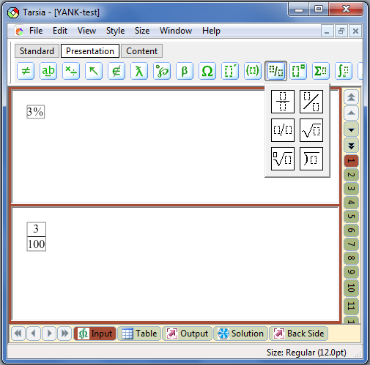
Typing pares of equivalent expressions
Upper(1) and lower(2) input slots are filled out with pairs of equivalent expressions. For math notation the expression toolbar is applied (3). Navigation between inputs (next or previous pair) can be made with the Right Hand Navigation toolbar (4) or pressing Shift+Alt+Up or Shift+Alt+Down key combination.
3
1
4
2
Notes:
Upper(1) and lower(2) input slots are to be filled out with pairs of equivalent expressions. As you see the tabbed view is switched to the presentation view, where you select the respective slot for making the authoring of a mathematical expression. Navigation between inputs can be made either with Right Hand Navigation toolbar (4) or via keyboard shortcuts: Shift+Alt+Up for previous input or Shift+Alt+Down for the next pair. Number (3) represents the division and radicals templates’ list – the one of those we were considering at the previous slide.

Slide 25
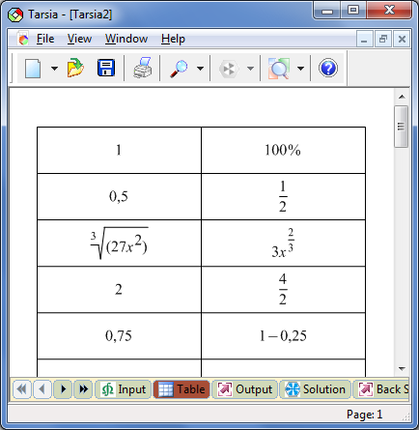
Check Inputs with Table View
Review typed inputs with Table view (1).
Once you have experienced a misprint or error, please get back to the input to edit the respective pare.
To change the output table scale please apply Zoom tool (2).
To change the expression scale – please use the respective button (3).
Print table with the Print button or select the File->Print menu.
2
3
1
Notes:
Table view is provided to check the equivalent pairs. Zoom tool enables the magnification of the page and the expression scale button enables to change the expression size. It will be further explained.

Slide 26
Output View
'Output' view allows you to display the current activity, and to use ‘Zoom’ to change the size of the view.
The level of magnification of the print out is controlled by the right-hand navigation bar using the ‘Normal size’, ‘Large size(8x3)’, ‘Normal (shaded)’ and Large 8x3 Shaded.
The ‘Large size’ options allow you to produce a large puzzle which might be helpful to learners with visual impairments.
The ‘Shaded’ outputs are designed to simplify the orientation of the inputs to reflect the solution in the chess-like style.
Notes:
There are several types of the output view, which differs by the style of printing (normal and shaded) and by the size (Normal and Large-size). ‘Large size’ buttons allow you to produce a large puzzle which might be helpful to learners with visual impairments. ‘Shaded’ outputs are designed to simplify the orientation of the inputs to reflect the solution in the chess-like style.

Slide 27
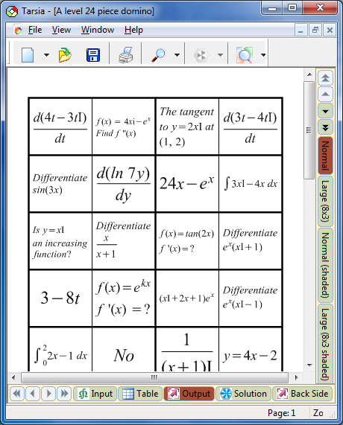
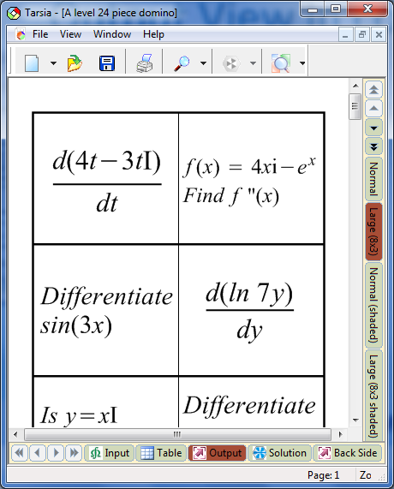
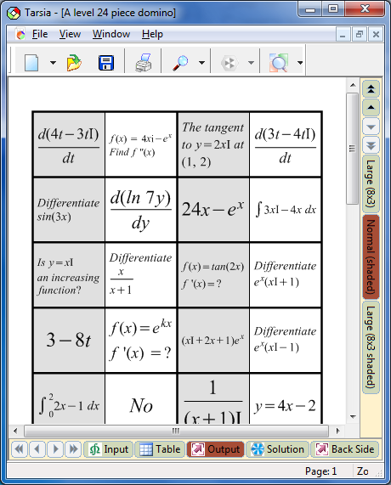
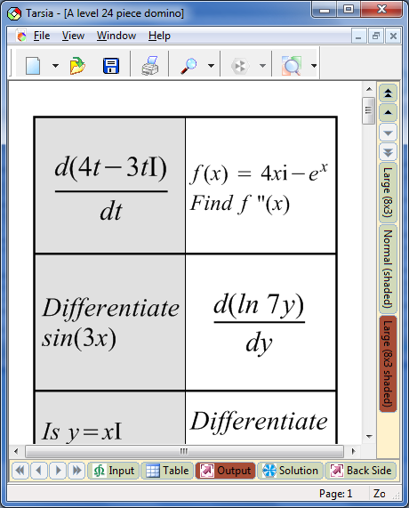
Output View in contrast
Notes:
Here we illustrate normal, large-size and shaded outputs.

Slide 28
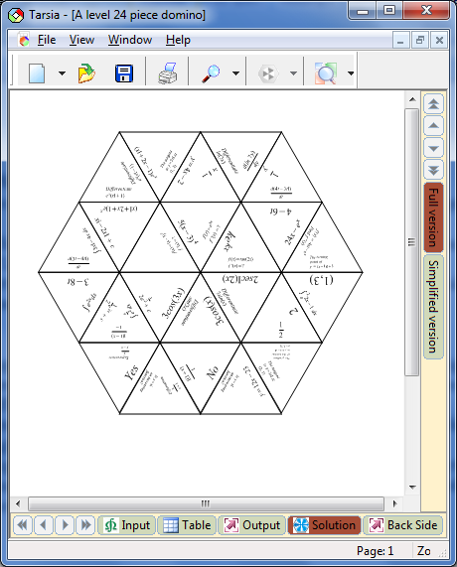
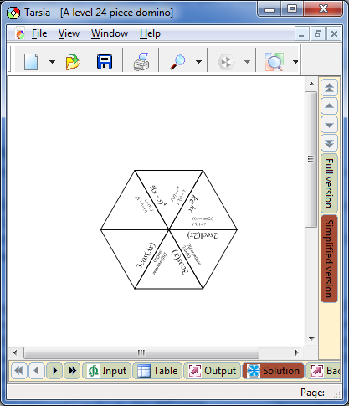


Simplified version of the activity
The 'Simplified version' of the hexagonal activity output gives only the central six triangles of the jigsaw.
Teachers and trainers can offer the simplified version of a jigsaw to learners who are finding the topic difficult and might benefit from a more limited choice of options.
To filter the for the simplified pairs Filtering Mode is available for Input View
Notes:
If the whole set of cards seems to be difficult to some of your pupils or students, please refer to the Simplified version. Learners will benefit from start with the simple version to understand the idea of putting the pieces together and then proceed with the full version.

Slide 29
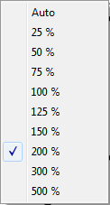
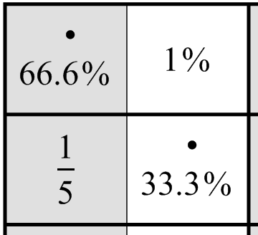
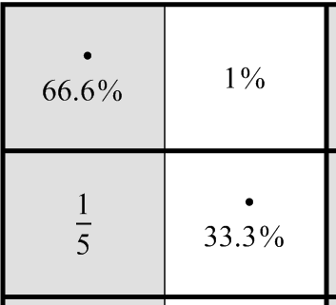
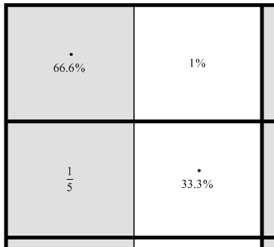
Scaling the expression
Expression output can be adjusted to the card-size, however it may be required the magnification of the text inside of each card.
Notes:
Whenever you need to change the expression size please apply to the Expression scale button available at the Table, Output, Solution and Background view. You do not need to adjust each expression with the new parameters, just scale them all and see the output until your needs are met.

Slide 30
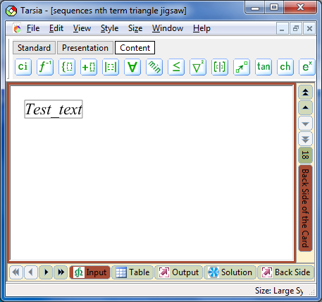
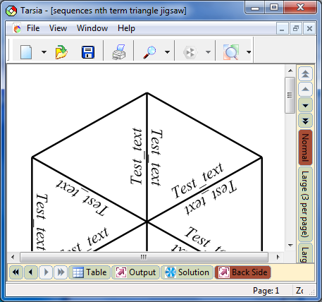
BackSide of the puzzles
BackSide of the puzzle is prepared as a separate set of pages. Such feature is useful to mark to what task the card belongs.
Notes:
Backside images and marks will be absolutely essential if you have numerous tasks to sort out. Different backgrounds for different files will let separate cards belonging to different tasks.

Slide 31
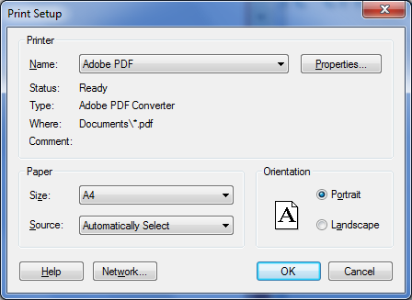
Printing Out the puzzles
Formulator Tarsia allows you to choose from many preset page sizes ranging from legal-size
paper and envelopes to the maximum page size the installed print-driver supports.
When printing to a file, it is necessary to determine first which printer — for
example, a PostScript printer — will ultimately print the file.
PDF files so easy to share with other teachers at the resources friendly to Tarsia.
Notes:
Besides settings of the parameters for printing directly it is possible to install PDF exchange driver. It will enables conversion of the puzzle to the PDF format. Such files are usually stored in the libraries and repositories of the math resources.

Slide 32

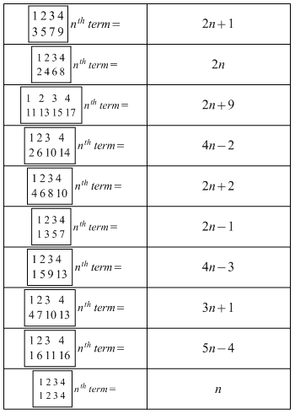
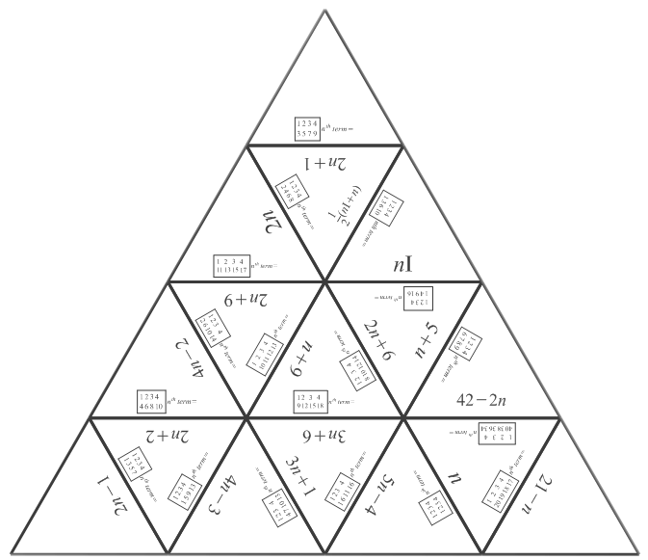
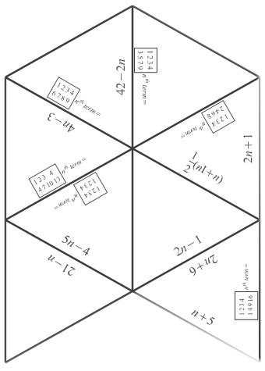
Printing outputs
Notes:
Let us demonstrate the printing outputs. The cards to be cut out, the table to check the correspondence of the equivalent pairs and the solution output, which is not to be given to the pupils or students. Solution is intended for the teachers, who has to check the solved tasks.

Slide 33
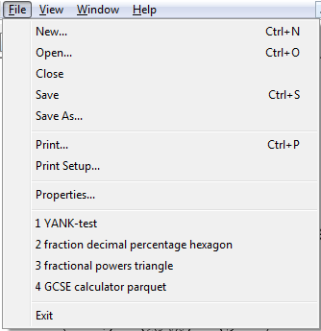
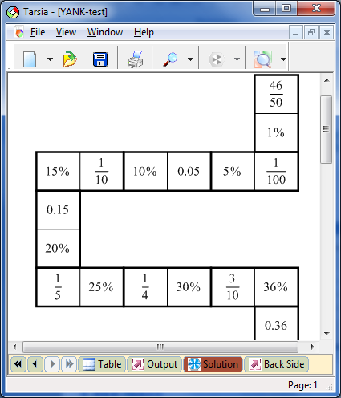
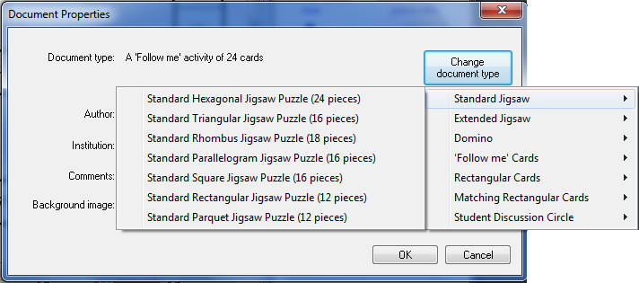
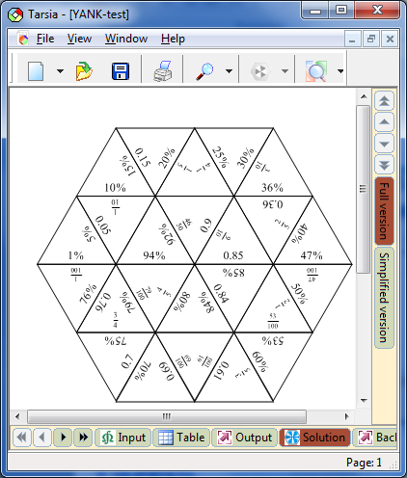
Changing the Activity Type
Notes:
You can easily transform one activity to one another. Changing of template is simple operation but cannot be reverted. Making change of bigger number of cards into smaller cannot be rolled back. Such functionality significantly simplify implementation of the tasks for the activity presented in different shapes.

Slide 34
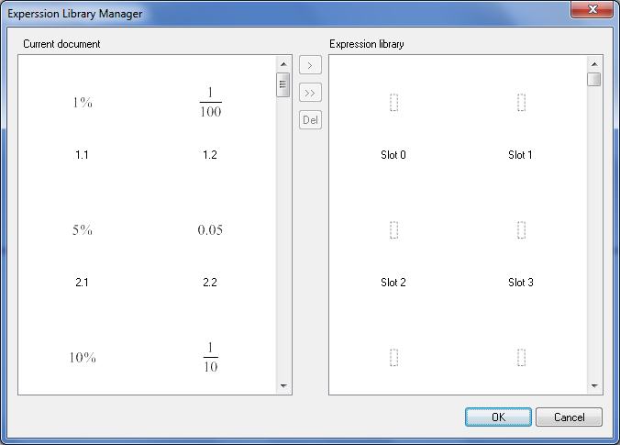
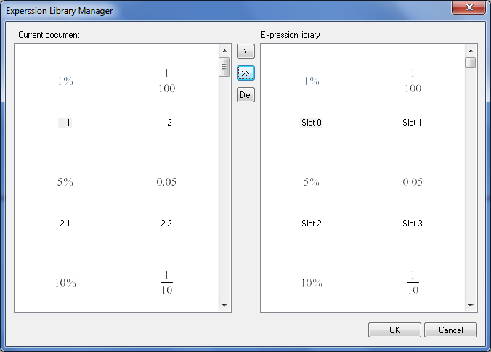
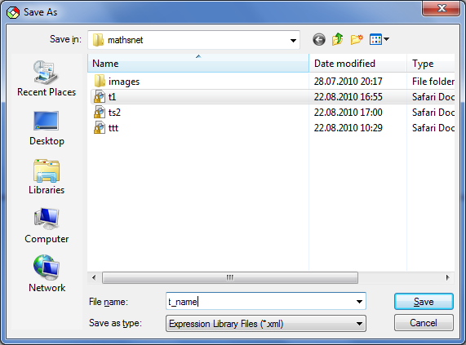
Expression Library
  Create the new Expression Library from existent file
  Further you just import expressions into the new activity.
Notes:
Expression library is intended to pass the input data between activities. Once typed equivalent expression pairs can be placed into the expression library and further, placed into the new activities by means of import of the intermediate xml files. You can pass either single expressions or import all of them at once. This operation is similar to the activity changing type with the difference you can customize what data you wish to place and at what place of the target file.
With the Expression library you can: create a new library, export data from the existent file to the certain library and you can import data from the library.

Slide 35
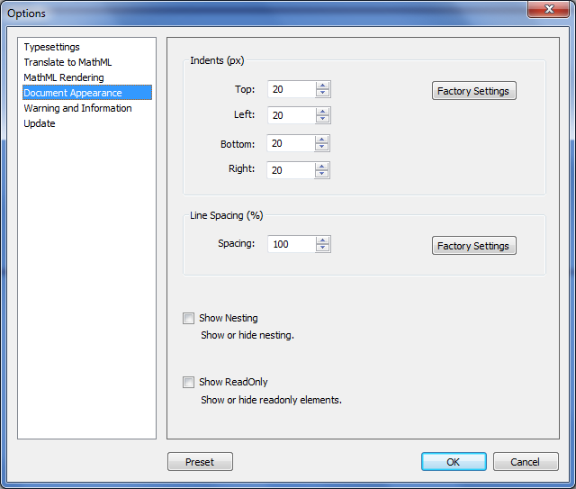
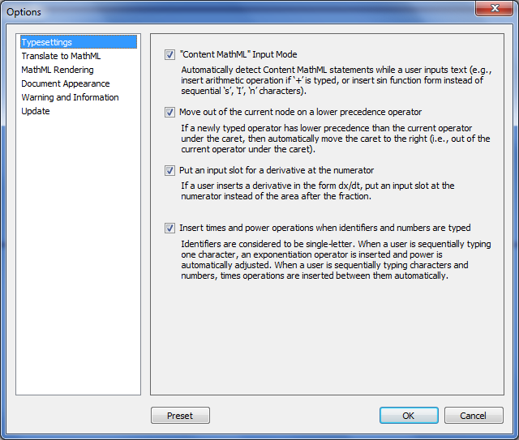
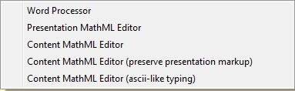
Options and Settings
Notes:
Options and settings adjust the software views along with basic functionality and settings for internal format processing. Following the options items user can adjust them according to the needs. Usability of the adjustment hides in the Presets, organized for the basic skilled customers, they can customize settings according to 5 possible profiles.

Slide 36


Architecture of Tarsia in brief
Formulator MathML
  The core software, which is regularly updated (with all supportive enhancements and improvements to come to Tarsia)
Support of XML
Templates management in open format
Notes:
Architecture of Tarsia is simple to explain: the core of the software represents Formulator MathML and the output of the software is provided in the XML format, which makes the transformation of the data very simple. Openness of the software is made basing on XML support for both: templates and data management.

Slide 37

Tarsia is known around the world
Major countries, where Tarsia is very popular are:
UK
USA
The rest of EU
UA
Historically the software distribution in UK is much higher than in the rest of EU; but USA also picked up the technologic advantages of Tarsia.
Notes:
Please have a look at the expansion of Tarsia to other countries. Historically it was originating in UK and then, it moved to the US along with the countries of EU and UA. The team receives the request from lots of countries and this number demonstrate the permanent growth.

Slide 38

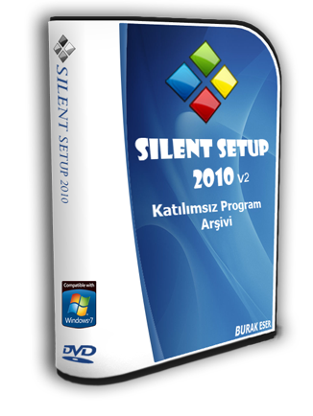
Standards & technologies supported
Education standards
SCORM (learning management systems)
SW Technologies and approaches
Click once technology - on demand
Silent setup
Notes:
Tarsia and its core Formulator are made according to the best practices of SCORM implementation. However, the latest technologies of Click-once and Silent setup are available on demand.

Slide 39

Formulator Tarsia Resources
Bryan Dye http://www.mathsnet.net/
Craig Barton
http://www.mrbartonmaths. com/jigsaw.htm
NANAMIC: http://www.nanamic.org.uk/
MathedUp! http://www.mathedup.co.uk/
Notes:
Here we listed just the most popular resources with Tarsia resources. Naturally the list is very large, but these are the most popular and some of these resources were included into the Tarsia main installation pack.

Slide 40


Didactic materials circulating and distribution
Format
  PDF -ready templates
  Jigsaw files
Repository
  Web-sites of enthusiasts
  Official web-sites of the societies
Notes:
Since Tarsia is friendly with PDF and gives an output in Jigsaw files: a lot of repositories are created on web sites of the math society. Quick exchange of the information and constantly increasing number of puzzles make Tarsia very popular around the world.

Slide 41

Service Management
Customers support
Incidents management (quick fixes);
Change management (additional functionality).
Functional extension
Enhancements and Features implementation;
Customization;
Notes:
Hermitech Laboratory provides all types of Service management, including Incidents and Changes. Functional extensions and customization is also available on demand.

Slide 42


Conclusion
Making learning activities with Tarsia is easy and fun
Easy share of the education material makes it absolutely useful for every teacher of Math
Numerous resources with various design and content of the activities
Exchange media: paper, PDF, MathML makes it absolutely valuable for every teacher.
Notes:
Thus you see, the software is easy to use. The resources are really numerous and since they are free as well as the software we presented you can download them and print for your pupils or students. The variety of designs and content will increase your performance greatly. Join to the society of teachers using Tarsia.
Remember: Tarsia will let you disclose your own genius and simplify your work with children. It is intended to make the education more fun and to make your job more oriented to thinking process rather than to do the routine.

Slide 43

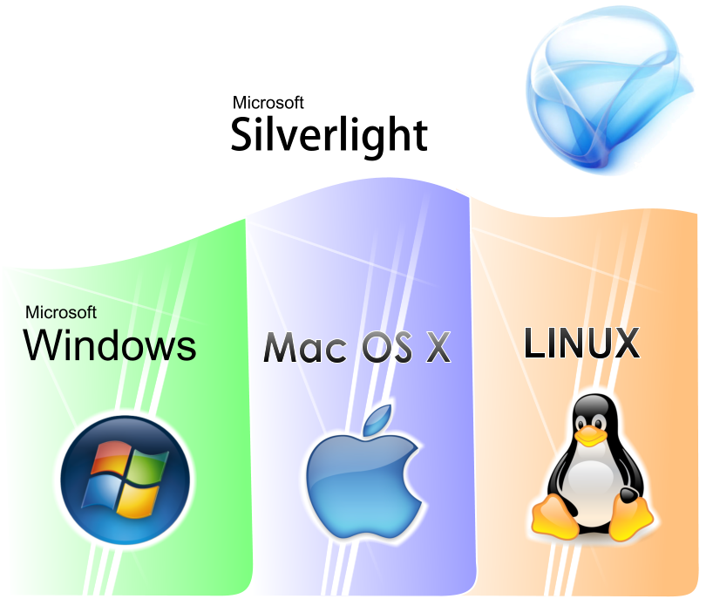
Further development of Tarsia
Multiplatform support;
Interactive version for PC;
3D shapes for puzzles.
Notes:
Our further plans of Tarsia development comprise porting it to other platform. Basing on your feedbacks we know whether our plans meet your real needs.

Slide 44
Tarsia and collaboration in Poland
Localization for Polish;
Customized templates;
Development of other software for education.
Notes:
The majority of teachers in schools will surely prefer to have national localized version of the software. This job is usually done on the basis of the National Grant, as we did with for other EU members countries. The team provides the customization: recently we collaborated with Sussex Down Colledge, which required the template Students Discussion Circle.
Initiating the application for the grant you can receive significant support for making change in Education and we can swiftly satisfy your request. The team is very well experienced in the International collaboration and successfully completed numerous projects in Tempus, NATO and other programs.

Slide 45


Questionnaire
The team encourages you to fill out the “Questionnaire” and return it to the author.
Notes:
Please pay attention to the Questionnaire and fill it out. It will be highly appreciated if you return it to us either during the conference or by the e-mail, given at the bottom of the paper.

Slide 46
Listeners’ feedback
We appreciate your opinion and intention to make the software more targeting your everyday needs.
Notes:
Your feedbacks will help us make Tarsia better and the one, meeting your everyday needs.

Slide 47

Questions and Discussion
Notes:
Now we can discuss the main notions of the materials you have learnt. We may have a look at the software right now, just running the software on the laptop. There are prepared specimens and we can start making our own puzzle to see the whole cycle of puzzle creation.

Slide 48

Thank you for your attention!

